Slide 1
Prioritizing patient centeredness and
Primary care development in an access free and fee for service health care system
The Belgian experience
R. De Ridder
Pisa 30/08/2010

Slide 2
A fee for service system
Health providers
charge
honorary fees
to
patients
Patients
get reimbursement from not for profit healthcare insurance bodies
(“mutuality's”)

Slide 3
A fee for service system
Reimbursement = based on nationally agreed tariffs
List of services (“nomenclature”)
  Actually ± 7,600 different services defined
  Positive list of 5,988 reimbursable medicine items
  Not all providers are bound by tariffs
  Tariffs are not always binding

Slide 4
A fee for service system
Reimbursement system
Out of pocket
2008 – 125 € per family per month (7% of monthly revenue)
Third party payer
Compulsory for hospitalization and pharmacies, voluntary in other sectors but not for all services and/or all insured

Slide 5
A fee for service system
Share of ambulatory services invoiced with third party payer
  Primary care
    GP consultations / visits 11 %
    Physiotherapy 12 %
    Dental care 21 %
    Home nurses 98 %
  Specialist services
    Consultations 14 %
    Dermatology 32 %
    Ophtalmology 66 %
    Imagery 84,5 %
    Biology 99,5 %
    Most other specialist service > 95 %

Slide 6
A fee for service system
Co-payments / Coinsurance
2008: 1,850,601,000 €
= 175.5 € / insured / year
  18.1% on GP consultations and visits (= 11.6% of total copayments)
  20.4% on ambulatory physiotherapy (= 6.8% of total copayments)
Additional out of pockets
  Above tariff
  Services not on the positive list

Slide 7
Access free
Use of GP-services
  Consultations = 3.08 / insured / year
  Home / Rest home visits = 1.40 / insured / year
  (2009 / NIHDI)
  94.5% declares having a dedicated GP
  77.7% has had at least 1 contact with GP during last 12 months
  (2008 – National Health Survey)

Slide 8
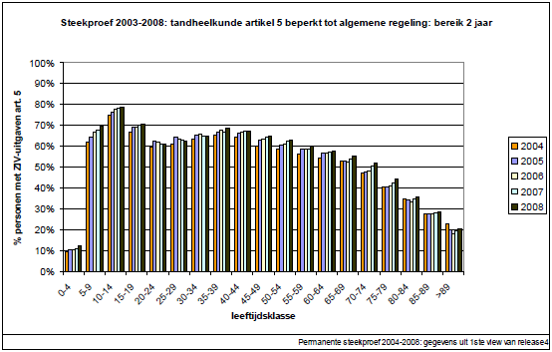
Access free
Use of Dental Care Services
NIHDI

Slide 9
Access free
Use of specialist services (2008 Health survey)
  48% of population had at least 1 specialist contact during last 12 months
  2.1 specialist contacts / person / year
  49% of new specialist contacts are on patients own initiative
  35% of new specialist contacts are GP referred

Slide 10
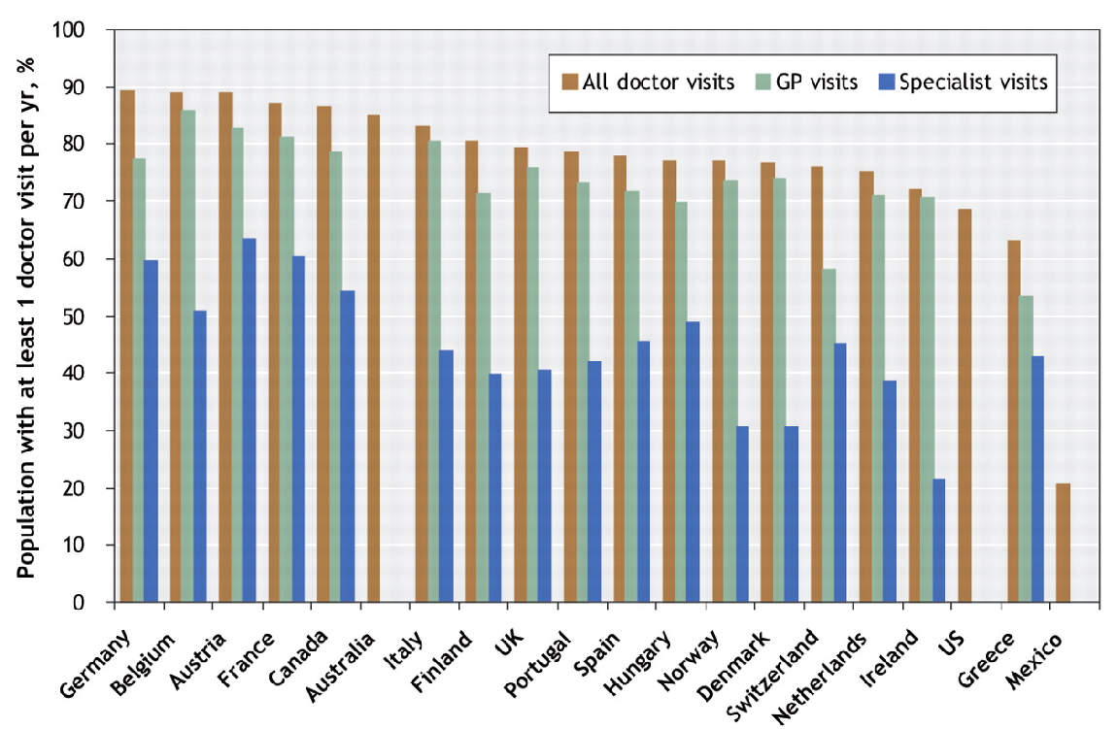
% of adult population consulting any doctor, general practitioner (GP) or specialist in 19 OECD countries within the previous 12 months in 2000 (van Doorslaer & all 2004)

Slide 11
Access free
  Use of emergency department
    Number of ER-contacts / 1,000 inhabitants (NIHDI data 2010)
    Contacts referred by GP
    2008: 31.7% (NIHDI data)
    Health Survey 2008: 79% of contacts not referred in 2008

Slide 12
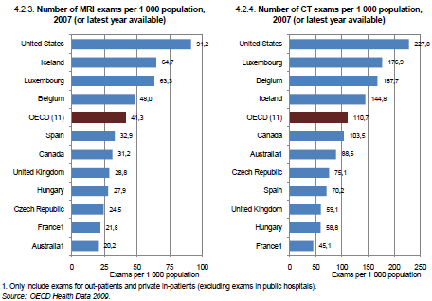
Use of services

Slide 13
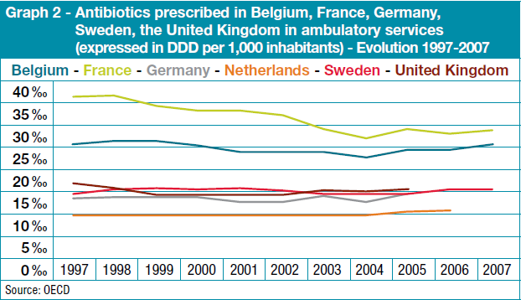
Use of services

Slide 14
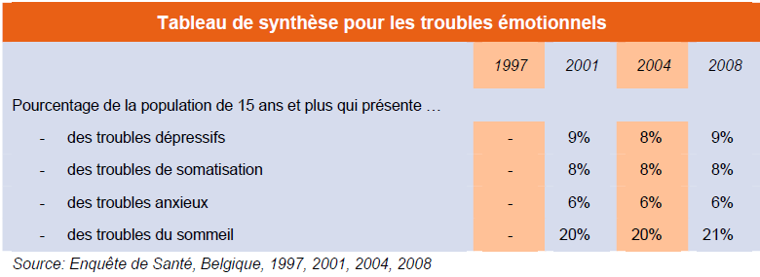
Use of services

Slide 15
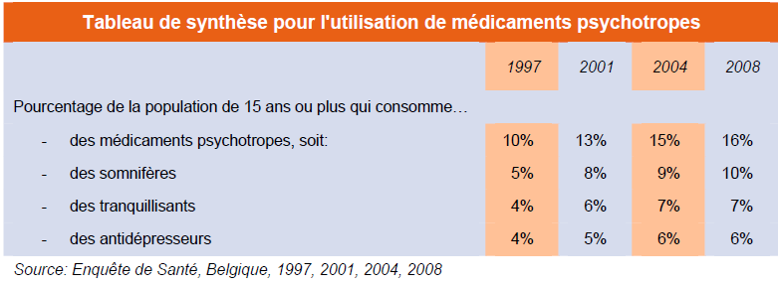
Use of services

Slide 16
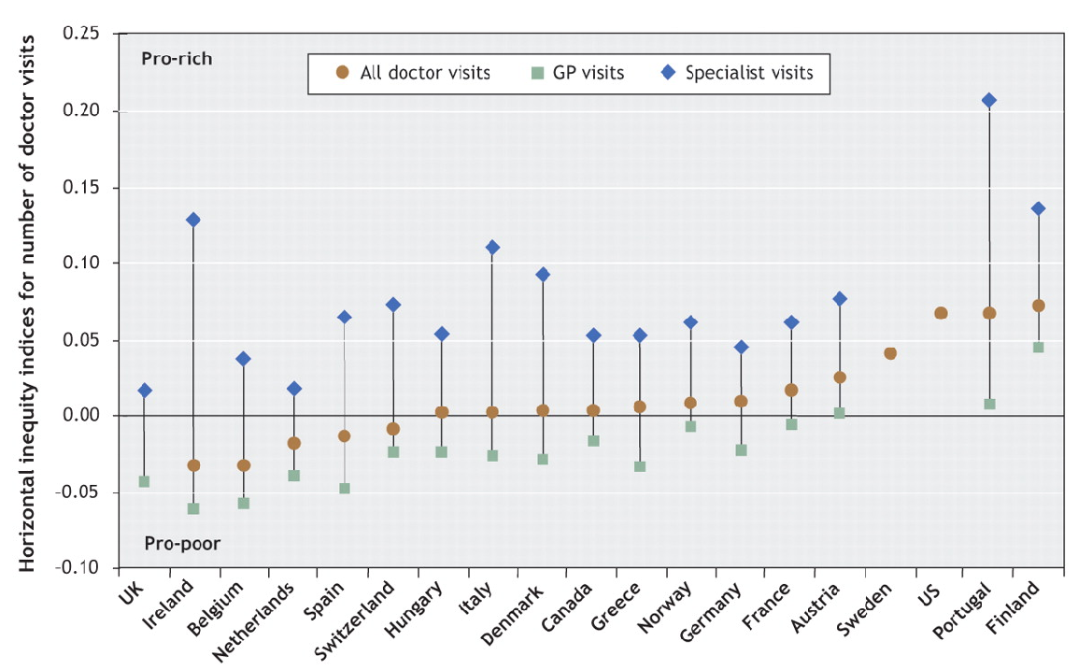
Inequity indices for the annual mean number of visits to a doctor in 19 OECD countries in 2000 (van Doorslaer & all 2004)

Slide 17
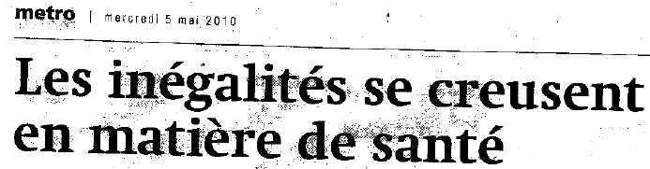
Equity

Slide 18
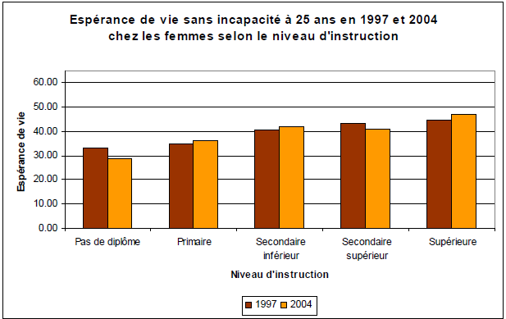
Equity
Source: Belspo

Slide 19
Equity
Share of families who declare to have difficulties to fit health expenditure in household budget
2008: 34.8% (67% for lowest income quintile)
2004: 29.8%
2001: 29.7%
1997: 33.1%
Share of families who declare to have postponed medical consumption
2008: 13.7% (29.6% for mono parental families)
2004: 9.5%
2001: 10.1%
1997: 8.5%
Source: Health surveys

Slide 20
Equity
Development of selective policies for preferential reimbursements, lump sums and ceilings for copayments based on family income and chronicity or intensity of costs
Out of pocket payment for consultation and home visit considered to be major hurdle to access health care by poverty reports

Slide 21
Workforce

Slide 22
Primary Care Organisation
Preponderance of self employed, single handed, mono disciplinary practices
e.g. GP: ± 24% working in group practices
Home nursing: 60% self employed in small groups (3 to 5 nurses)
2 % of population served by integrated primary care teams (“local health centers”)
Weak primary care support structures:
  GP-”circles” only at the beginning of professionalization
  “Integrated Home Care Services”
  Palliative platforms
  Integrated care projects in mental health care and LTC

Slide 23
Patient Empowerment
Mutualities – not for profit member organisations – held longtime monopoly on patient interest representation
2002 : patient rights act
Only recently formal recognition of patient organisations in NIHDI

Slide 24
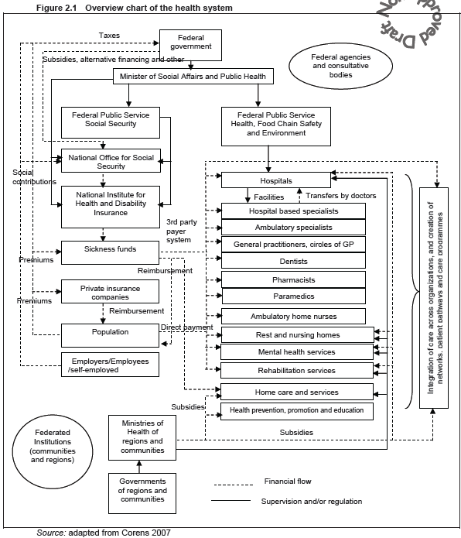
Health System Design

Slide 25
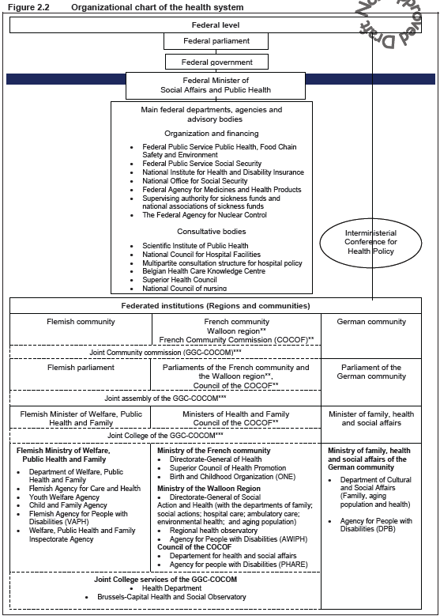
Health System Design

Slide 26
Health No System
System sometimes called
Design System

Slide 27
Same global characteristics
Social security based
Based on vertically segmented national agreements between “providers” and “insurers”
Weak patient empowerment until recent past (except for free choice)
Professional corporatism
Budget led short term policies within a generous allowed growth rate (4.5% real)

Slide 28
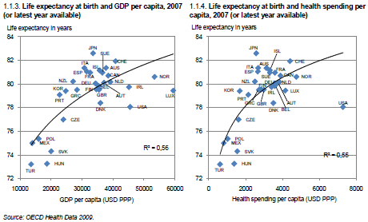
Performance

Slide 29
Starfield, Shi : Health policy 60 (2002) - abbreviated

Slide 30
Primary Care scores
Some critical system and practice characteristics
Low or no patient cost sharing for PC services ⁽¹⁾ → NOK
Degree of comprehensiveness of primary care ⁽¹⁾ → NOK
Coordination → NOK
Community orientation → NOK
(1) according to B. Starfield & L. Shi; 2002; Health Policy

Slide 31
(OECD – 2009)

Slide 32
(OECD – 2009)

Slide 33
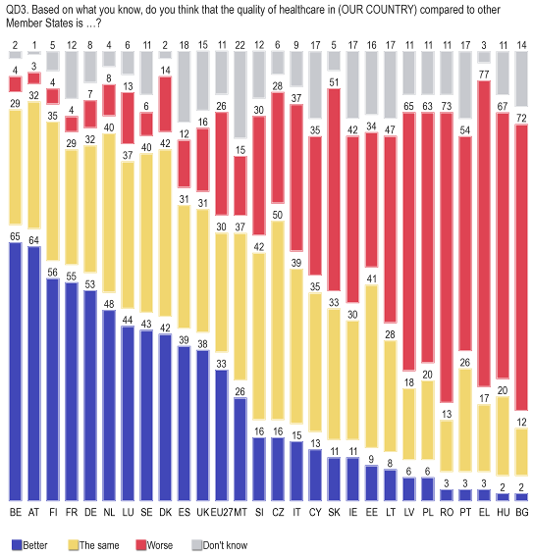
BUT YET !
Eurobarometer

Slide 34
Policies developed
Turning point 1999 and 2002
  1999 : - GP professional training finally regulated
    - Planification (e.g. GP’s / specialists ratio)
  - Global medical file
  2002 : - Start of development of Primary Care Policy
  on federal state level

Slide 35
Strengthening GP’s position in the system (1)
Patient incentives :
  lower payment through GMF
  differentiation of co-payment paid in E. R.
  Soft gatekeeping
  Care pathways
Supporting : GP service development and attractiveness through :
  Lump sum payments :
    for holding GMF
    for applying electronic MF
    for first settlement (interest-free loan)

Slide 36
Strengthening GP’s position in the system (2)
Supporting : GP service development and attractiveness through :
  Lump sum payment :
    for settlement in deprived or underserved area (premium)
    for on call duties
    for group practices
    for employing staff
  Specific regulation for GP trainees
  GP referral required for certain chronic disease management programs (e.g. geriatric assessment)

Slide 37
Strengthening GP’s position in the system (3)
Results (1) :
  Higher GP share of expenses for medical fees
  Share of fee for service in total GP revenues
    2000 : 97,42 %
    2010 : 79,90 %
 | 2000 | 2010 ⁽¹⁾
GP’s | 16,3 % | 18,9 %
Specialist | 83,7 % | 81,1 %
(1) Based on budget NIHDI

Slide 38
Strengthening GP’s position in the system (4)
Results (2) :
  GP revenue 2005 (full time / Belgium ⁽¹⁾)
(1) Kronema et al 2009; Income development of General Practitioners in eight European Contries from 1975 To 2005 : The calculation of the Belgian General Practitioner revised – BMC Health Services Research. Vol 9, nr 26
 | In € | In ppp VS $
Total revenu | 118.261 | 131.401
Income | 71.514 | 79.460
(= comparable to France, Sweden, Finland)

Slide 39
Promoting GP inclusive multidisciplinarity (1)
Creation of primary care supporting platforms and teams : in palliative care, mental health, LTC; integrated home care services (IHCS)
Payment for time spent on multidisciplinary team discussions (ADL-dependency, oncology, CFS, chronic pain, …)
BUT : often GP agenda doesn’t fit with other team members agenda

Slide 40
Promoting GP inclusive multidisciplinarity (2)
Local GP organisations (“circles”) obligatory partner in IHCS and even organizing power for local multidisciplinary networks (in care pathways)
Promoting “transmural care” with primary care professionals representative organisations
(≠ teams !!)
Promoting medico-pharmaceutical team discussions

Slide 41
Supporting primary care quality development and information support
Developing electronic medical file as an information source and as decision making support tool (GP, physiotherapy, home nursing, pharmacy)
Investments in guidelines development and disclosure
Support for systematic clinical data collection
Investment in primary care research
Making use of the official quality accreditation system through “animators” and information feedback

Slide 42
ICT-strategy
Moving towards open source IT – solutions for key-functions (like automatic coding, decision support, clinical data collection, auto feedback, …)
Creation of public e-health platform (21/08/2008)
warranting safety and neutrality of data exchanges

Slide 43
Disease management (1)
2009 : “Care pathways”
Conceptually based on chronic care model and specific action research on diabetes management programs (commissioned by NIHDI)
Considered by professional organisation as an alternative to gate keeping regulations

Slide 44
Disease management (2)
Major characteristics (1)
  4 year contract between patient, GP and specialist
  Actually limited to 2 chronic diseases with limited inclusion criteria
    Diabetes type 2 at the stage of considering insulin therapy (since 01/09/2009)
    Chronic renal failure at stage 3b (since 01/06/2009)
  capitative fees for both GP and specialist
  100 % reimbursement for GP & specialist consultations

Slide 45
Disease management (3)
Major characteristics (2)
  Formal conditions on GP & specialist minimum consulting frequency
  Compulsory transmission of minimal clinical data set by GP’s to scientific body (+ coupling with other reimbursement data on individual patients)
  → evaluation and feedback

Slide 46
Disease management (4)
Supporting incentives
  Reimbursement for patient education and for self management devices
  Guidelines & electronic tools
  Local multidisciplinary networks
  Collaboration with patient organisations and mutualities
First results
number of contracts invoiced until 4/2010:
  Renal failure : 6.862
  Diabetes : 5.656

Slide 47
Conclusions (1)
(from a health system perspective)
System change depends on
  External pressure
    growing international attention for systems sustainability enhancing strategies (like WHO, OECD, ….)
      → real impact on national policies
      → “evidence” finds its way in transnational bodies
  Internal “strategic” interventions
    Creating evidence in health services research
    Low cost investments can make a difference
    Be operationally close to the “mainstream” professional (e.g. pratical IT-solution)

Slide 48
Conclusions (2)
(from a health system perspective)
System change depends on
  Incremental but strategic “little steps” (like transmission of minimum clinical data set which makes GP’s partner of scientific network)
System change takes time
  To take place
  To appear in evidence

Slide 49
Conclusions (3)
(from a health system perspective)

